Slide 1

PHISHING ATTACKS AND KEYLOGGER
PROJECT
NAME – GOKUL S
REG NO- 510821205008
COLLEGE NAME – GANADHIPATHY TULSI’S JAIN ENGINEERING COLLEGE
DEPT – B.TECH- INFORMATION TECHNOLOGY
Notes:
https://www.freepik.com/free-photo/futuristic-technology-screen-interface_7136702.htm#page=1&query=cyber&position=0

Slide 2
PROBLEM STATEMENT
It’s a common phenomenon to put bait for the fish to get trapped. Similarly, phishing works. It is an unethical way to dupe the user or victim to click on harmful sites. The attacker crafts the harmful site in such a way that the victim feels it to be an authentic site, thus falling prey to it.
Keyloggers Can Also Be Used To Steal Data In The Form Of Malware Or Other Similar Threats. To Solve This Problem, We'll Also Develop An Anti-key Logger That Will Let Us Know If A Key Logger Is Already Watching The System. The Anti-keylogger Will Allow Us To Continue To Be Vigilant And Ensure The Security Of The Data On Our System.

Slide 3
PHISHING ATTACK
Here, the medium used to commit crime digitally is the computer, network, internet, or any electronic device.
The main targets of cybercrime are users of the system, websites, company defamation, gaining money, etc.
Spread viruses and Gaining malware
Generate profit by selling or locking crucial data.
unauthorized access to user accounts
It is a way to steal your data or monitoring your systems to make attacks and threating us

Slide 4
METHOD OF ATTACKS
Email Spoofing: The attackers impersonated XYZ Bank's official email domain to send convincing emails to customers.
Malicious Links: The phishing emails included links to spoofed websites designed to mimic XYZ Bank's login page
Social Engineering Tactics: The emails employed psychological manipulation techniques to create a sense of urgency and fear, compelling recipients to provide sensitive information without questioning the legitimacy of the request

Slide 5
KEYLOGGER
It's Challenging To Covertly Install A Hardware Key logger On Another Person's Device. To Tackle This Issue, We Are Therefore Using A Software Key logger That Can Be Remotely Installed On A Person's PC To Resolve This Problem. Without The Device Owner's Knowledge, The Key logger Would Be Running In The Background.
Despite efforts to mitigate such risks through antivirus software and security protocols, key loggers persist as a persistent threat, undermining the integrity of personal and organizational cybersecurity measures, potentially resulting in identity theft, financial fraud, and unauthorized access to sensitive systems and data.

Slide 6
PROPOSED SYSTEM
The solution to the above existing problem is that we can build a software keyloggers instead of hardware keyloggers. The proposed model provides the solution that reduces the difficulties while installing the keylogger in the target system. Since, software keylogger can be installed remotely and does not need any physical access of the target system. Proposed software is efficient enough to get installed in targeted system by itself when the user for example clicks the malicious link sent to him through mail or any social media and finally captures all the keystrokes of the user while he is logged into the system, saves the logs in a folder or sends the log directly to the mail address of the third party.

Slide 7
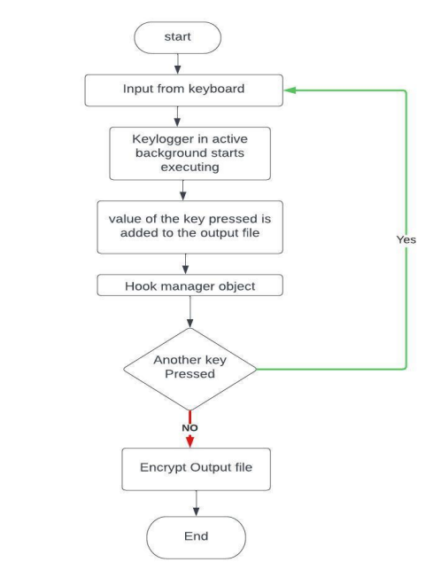
GENERAL REPRESENTATION OF KEYLOGGER
Notes:
https://www.flaticon.com/free-icon/spam_927958?term=EMAIL%20SPAM&page=1&position=46

Slide 8
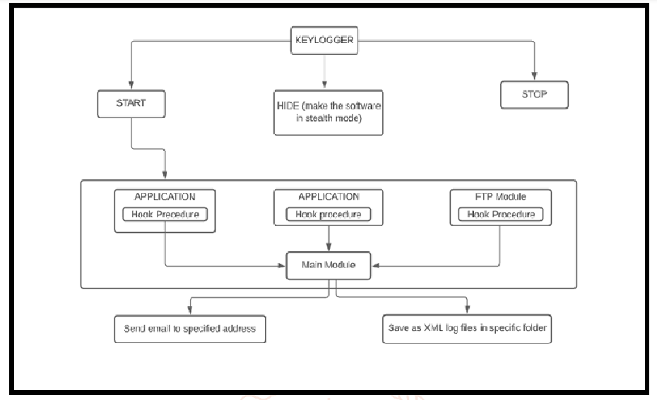
SYSTEM ARCHITECTURE

Slide 9
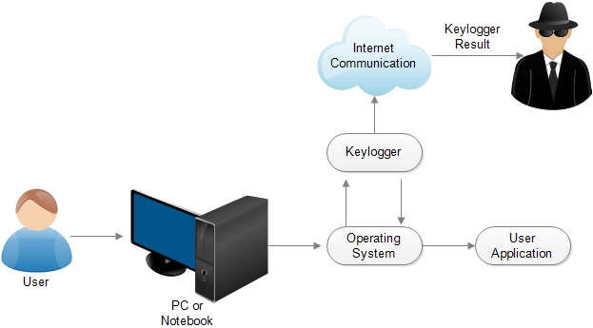
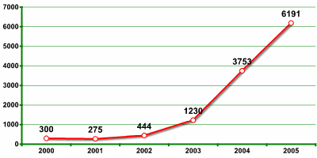
SYSTEM APPROACH
INCREASED USE OF KEYLOGGERS BY CYBER CRIMINALS
.
SYSTEM FLOW DIAGRAM
Hardware Requirements:
1. Pentium Class or higher Processor
2. Minimum 64 MB RAM
3. 20 MB Free Disk Space Software Requirements:
1. Windows XP/Vista/7/8/10
2. Python IDE

Slide 10
ALGORITHM
The keylogger algorithm plays a crucial role in capturing and processing keystrokes effectively while ensuring the system's efficiency and reliability.
Below is an outline of the keylogger algorithm:
Initialization:
Initialize the keylogger system, including setting up event listeners and data structures to store captured keystrokes.
Keystroke Capture:
Continuously monitor keyboard events using event listeners, capturing each keystroke as it occurs.
Record the timestamp, key type (pressed, held, released), and the corresponding key code or character.
Data Processing:
Preprocess the captured keystrokes to filter out irrelevant or redundant information.
Organize the keystroke data into a structured format for storage and analysis, such as JSON or CSV.
Notes:
https://www.freepik.com/free-photo/profile-portrait-young-woman-hand-her-forehead_1281231.htm#page=1&query=ERROR&position=23

Slide 11
. Storage and Logging:
Store the processed keystroke data securely, ensuring encryption and protection against unauthorized access.
Implement logging mechanisms to maintain a record of all keystrokes captured over time, facilitating analysis and forensic investigations.
User Interface Interaction:
Develop user interface components to interact with the keylogger system, including options
for starting/stopping logging, viewing logs, and configuring settings.
Notes:
https://www.freepik.com/free-photo/profile-portrait-young-woman-hand-her-forehead_1281231.htm#page=1&query=ERROR&position=23

Slide 12
The deployment of the keylogger system involves preparing the software for installation and usage in various environments. Here's an overview of the deployment process:
Installation:
Install necessary packages using pip:
C:\Users\name>pip install pynput
Download the keylogger script (keylogger.py) onto the target system.
Configuration:
Modify any configuration options in the keylogger script as needed (e.g., output file path, logging settings).
Execution:
Open a terminal or command prompt.
Navigate to the directory containing the keylogger script.
Run the keylogger script using Python:
C:\Users\name>python keylogger.py
DEPLOYMENT

Slide 13
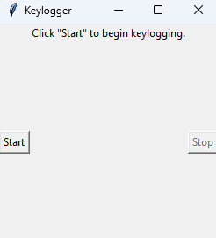
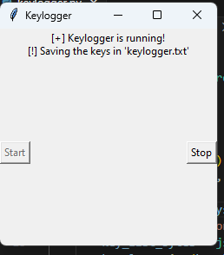
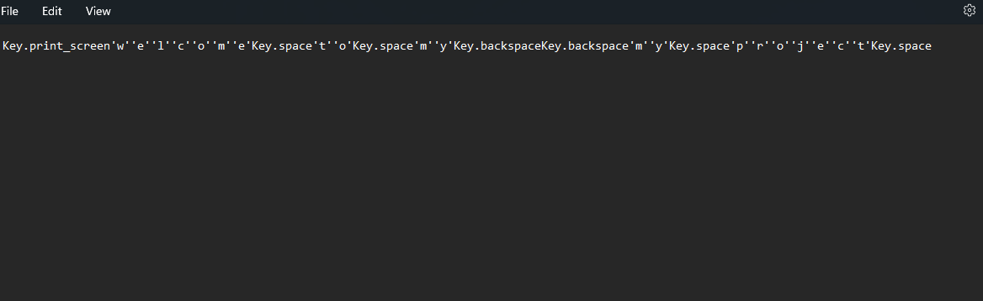
RESULT
BEFORE START
AFTER START
LOG FILE
Notes:
https://www.freepik.com/free-photo/profile-portrait-young-woman-hand-her-forehead_1281231.htm#page=1&query=ERROR&position=23

Slide 14
CONCLUSION
In Conclusion, The Development And Implementation Of The Keylogger System Present A Significant Advancement In Enhancing Cybersecurity Measures And Monitoring User Activity. Through Continuous Monitoring And Logging Of Keystrokes, The System Provides Valuable Insights Into User Behavior, Aiding In Threat Detection And Forensic Analysis. The Intuitive User Interface Facilitates Seamless Interaction And Configuration, Empowering Users With Control Over Logging Operations. With Robust Anomaly Detection Capabilities And Comprehensive Record-keeping, The Keylogger System Offers A Proactive Approach To Cybersecurity, Mitigating Risks Associated With Unauthorized Access And Malicious Activities. Overall, The Keylogger System Serves As A Valuable Tool For Bolstering Security Measures And Safeguarding Sensitive Information In Both Personal And Organizational Settings.
Notes:
https://www.freepik.com/free-photo/profile-portrait-young-woman-hand-her-forehead_1281231.htm#page=1&query=ERROR&position=23

Slide 15
FUTURE SCOPE
Looking Ahead, The Keylogger System Holds Promise For Further Enhancements And Expansions To Address Evolving Cybersecurity Challenges. Future Iterations Could Incorporate Advanced Machine Learning Algorithms To Improve Anomaly Detection And Recognize Complex Patterns Indicative Of Suspicious Behavior. Additionally, Integration With Cloud-based Platforms Could Enable Centralized Logging And Analysis, Facilitating Real-time Threat Intelligence And Proactive Incident Response. Moreover, Enhancing Compatibility With Emerging Technologies Such As Internet Of Things (Iot) Devices And Mobile Platforms Would Extend The System's Reach And Effectiveness In Diverse Environments. Collaborative Efforts With Cybersecurity Experts And Industry Stakeholders Can Foster Innovation And Refinement, Ensuring The Keylogger System Remains At The Forefront Of Cybersecurity Defense Strategies. Ultimately, Continued Research And Development Efforts Will Propel The Keylogger System Towards Greater Resilience And Adaptability In Safeguarding Against Evolving Cyber Threats.
Notes:
https://www.freepik.com/free-photo/profile-portrait-young-woman-hand-her-forehead_1281231.htm#page=1&query=ERROR&position=23

Slide 16
REFERENCE
GeeksforGeeks. (n.d.). Design a Keylogger in Python. Retrieved from https://www.geeksforgeeks.org/design-a-keylogger-in-python
ThePythonCode. (n.d.). Write a Keylogger in Python. Retrieved from https://thepythoncode.com/article/write-a-keylogger-python
Python Documentation. (n.d.). Retrieved from https://www.python.org/doc/
Tkinter Documentation. (n.d.). Retrieved from https://docs.python.org/3/library/tkinter.html
Pynput Documentation. (n.d.). Retrieved from https://pynput.readthedocs.io/en/latest/
JSON Documentation. (n.d.). Retrieved from https://docs.python.org/3/library/json.html
Various online tutorials and forums for Python programming and cybersecurity practices.
Notes:
https://www.freepik.com/free-photo/profile-portrait-young-woman-hand-her-forehead_1281231.htm#page=1&query=ERROR&position=23

Slide 17

THANK YOU
Notes:
https://www.freepik.com/free-photo/business-corporate-protection-safety-security-concept_3533269.htm#page=1&query=cyber%20security&position=0

